Slide 1
DIGITAL TRANSFORMATION AND DATA MANAGEMENT Professor Bellini
ALI DAVARI DOLATABADI
1994561

Slide 2
Introduction
Defining Amazon Business Model can be kind of a curious task, as we observe that this global trade giant increases its reach year by year, both geographically and in terms of products and services offered. To give you an idea of ​​the size of the business we’re talking about, in the time it takes you to read this simple article, Amazon may have added about a million dollars more to its revenu

Slide 3
Amazon’s Mission Statement
Amazon is guided by four principles: customer obsession rather than competitor focus, passion for invention, commitment to operational excellence, and long-term thinking. Amazon strives to be Earth’s most customer-centric company, Earth’s best employer, and Earth’s safest place to work.

Slide 4
How Amazon makes money
To understand how Amazon makes money, we need to take a look at each of the different operations that are under this big corporate umbrella. They are:
Amazon Marketplace: The company’s first revenue stream, Amazon.com accounts for more than 50% of the income. Basically, Amazon asks for a fee from its sellers to promote and advertise their products;
Amazon Prime: It is Amazon’s subscription business model and has been vital to the brand’s growth. In exchange for a monthly fee, subscribers have access to the platform’s video and music streaming catalog, free two-day shipping, unlimited photo storage, etc. Prime currently has more than 150 million members;

Slide 5
Amazon Web Services: It is a low-cost complete IT structure platform, whose services are contracted by companies, organizations, and institutions around the world. It’s not the main source of revenue, but it is certainly the most profitable one;
Amazon Kindle: It is Amazon’s e-reading service, where users can buy, browse and download books, magazines, and newspapers, that are available at Kindle Store. Amazon doesn’t make much money from Kindle itself, but by attracting traffic to the Prime membership plan. Besides, the platform allows independent authors to publish their info-products and e-books, charging something between 30 to 70% of royalty fees from the sales;

Slide 6
Amazon Patents: The company has more than 1,000 patents, several of which are licensed by other companies;
Amazon Advertising: Amazon Ad platform offers sponsored ads and videos. It is a very efficient marketing channel, since the audience that accesses the platform is already there with the intention to buy something.

Slide 7
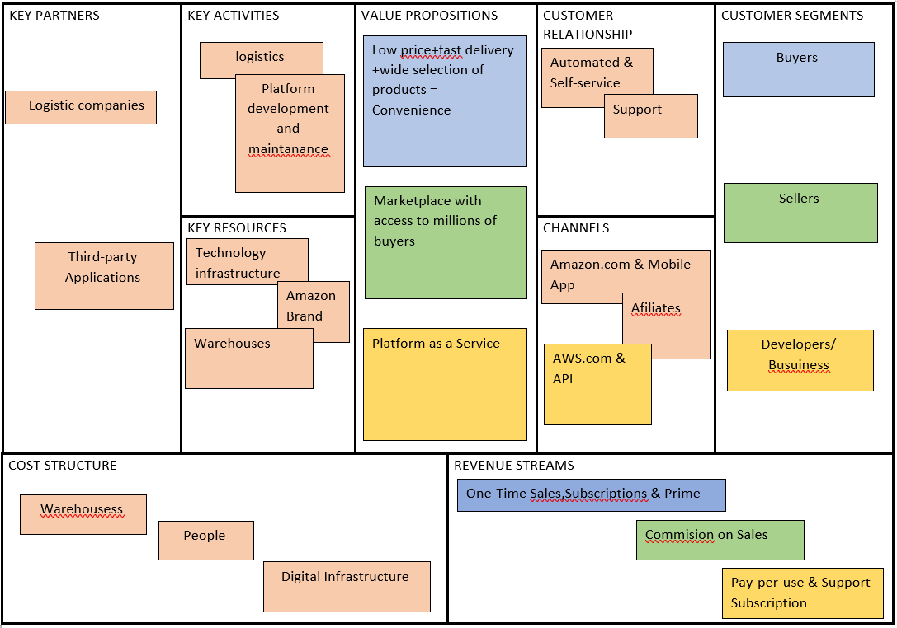
Amazon’s Business Model Canvas

Slide 8
VALUE PROPOSITIONS
For fast moving consumer goods, availability is key to the success of the company and a major value proposition. For supermarkets and retail chains, distribution partners are key if you want to provide your fast moving consumer goods to the market. Your advantage is that your products will be available to everyone, but the supermarket will drive down your price and resultantly your margins significantly.

Slide 9
Technologies are advancing at a very high rate that increases their risk factor is well. However, if the technology forms a significant value proposition for your business, then you can take on a partner to share the risk and cost associated with the technology in question.
Focus on where you are creating value but consider that the rest can be outsourced if needed. The activities that are adding value to your value proposition must be outsourced very carefully because they are the ones that are key partnerships for your business.

Slide 10
Amazon’s Customer Segments
The customer segments of Amazon can be divided into basically three groups: sellers, buyers, and developers.
Sellers are all the companies that use Amazon’s e-commerce platform to sell their products to its wide audience.
Developers are all the community involved with Amazon Web Services (AWS) — Amazon’s cloud computing platform. As its own website states, they are customers and partners “across virtually every industry and of every size, including startups, enterprises, and public sector organizations”.
And the buyers are the millions of people across the world who acquire products and services through Amazon’s channels. Amazon tracks its customers based on some characteristics, such as interest, engagement, and personal information (age, gender, geographical space, language, among others).

Slide 11
Amazon’s Value Propositions
Jeff Bezos defines that Amazon’s business model is based on three value propositions: low price, fast delivery, and a wide selection of products. However, looking at these three consumer benefits, we can say that Amazon’s greatest value proposition is convenience because the audience understands that, with just the help of a device connected to the internet, they have access to the product catalog of the largest retailer in the world, with a reasonable price and an agile, safe and reliable delivery service.

Slide 12
Amazon’s Channels
Certainly, the Amazon website is its largest and most important channel. But important channels also include the brand’s app, Amazon Prime (its streaming, entertainment, and subscription platform), and its affiliate program. As an internet-based company, its marketing is basically digital, including advertisements, sponsored publications, and e-mail marketing. Overall, the company invested more than ten billion dollars in media in the year 2019.

Slide 13
Amazon’s Customer Relationships
Amazon’s focus, no doubt, is to have a healthy and long-lasting relationship with its customers. For this reason, they maintain several communication channels open with their consumers — such as reviews and comments on the platform, telephone, online chat, and e-mail contact. Plus, they don’t usually take a lot of days to give feedback.

Slide 14
Amazon’s Revenue Streams
One-Time Sales
Commission on Sales
Advertising
Subscriptions (Amazon Prime)
Web Services (AWS)
Licenses
Patents
Pay-Per-Use & Support Subscription

Slide 15
Amazon’s Key Resources
Hands down, “the one” Key Resource of Amazon is its technological infrastructure, which needs to be broad and very secure, in order to keep the whole chain running without interruption or losses (back in 2013, Amazon was down for about 40 minutes, which resulted in a loss of more than US$ 5 million in sales). Aside from that, other key resources include physical spaces of the company, such as offices, warehouses, supply chain structure, and automation, among others. And, of course, human resources are essential for Amazon, which needs to guarantee A-players among its designers, engineers, developers, etc.

Slide 16
Amazon’s Key Activities
Amazon’s key activities are all about the development, maintenance, and expansion of its gigantic platform. Therefore, the brand invests in website and app development and management, management of the entire supply chain, storage and logistics, information security on all platforms (including e-commerce, streaming, cloud computing, etc.), production of films, series, and other products for its video platform, as well as marketing for all of its products and services.

Slide 17
Amazon’s Key Partners
Sellers: Certainly the most important partners of the brand, since they are the generators of Amazon’s first source of revenue. There are approximately 8 million worldwide, which guarantees more than half of the company’s revenue;
Affiliates: Bloggers who earn a commission for any referrals that lead to a sale. In addition to helping with sales, they promote traffic to the platform;
Developers: They are the partners of the AWS segment, or, as Amazon itself defines, “thousands of systems integrators who specialize in AWS services and tens of thousands of independent software vendors (ISVs) who adapt their technology to work on AWS”;
Content creators: Independent authors who can publish their works through Kindle Direct Publishing;
Subsidiaries: They include companies that provide storage spaces, stores, and systems, in addition to brands and products developed by Amazon itself, such as Amazon Essentials, Amazon Elements, Amazon Elements, Kindle, Alexa, etc.

Slide 18
Amazon’s Cost Structure
The cost structure of Amazon includes its complete IT structure, customer service center, software development and maintenance, information security, and marketing, as well as all expenses involved in maintaining its physical spaces, such as fulfillment centers, sortation centers, and delivery stations.

Slide 19
Amazon’s Competitors
Online stores: It’s estimated that there are over 24 million online stores nowadays. Especially regarding knowledge and quality, smaller niche shops can be “stronger” than Amazon in their fields;
Walmart: Although a large percentage of its sales comes from brick-and-mortar stores, this is another global giant with a significant presence online, being the second most popular online store in the U.S.;
Alibaba: A China-based online retailer, specialized in wholesale selling online. It splits into separate businesses. Alibaba is focused on B2B, Taobao on B2C, and Tmall on multinational brands;
Otto: An European online retailer, that sells products from other brands on its platform. With a user-friendly interface, some top categories include fashion, electronics, housewares, and sports;

Slide 20
Jingdong (JD): Another Chinese e-commerce, and a direct competitor of Tmall (from Alibaba). It also has an English language version, Joybuy.com, which ships to more than 200 countries;
eBay: The pioneer in C2C online selling has evolved to offer B2C sales. Regarding visits, it only loses to Amazon and stands for about 20% of the market share;
Flipkart: The largest online retailer in India, founded in 2007. In 2018, Walmart acquired 77% of Flipkart’s shares. Nowadays, there are more than 100 million accounts registered on the platform;
Rakuten: Japanese e-commerce company, controlling over 14% of the total global e-commerce market. It has bought some other companies around the globe to expand its online presence;
Newegg: The global leader in selling electronics (computers, TVs, cameras, phones, etc.) — consider that electronics is Amazon’s most popular category.

Slide 21
Amazon’s SWOT Analysis
Amazon’s Strengths
Amazon’s Weaknesses
Amazon’s Opportunities
Amazon’s Threats

Slide 22
Amazon’s Strengths
Brand: Being an e-commerce giant, Amazon has a strong brand image in the market, and it’s ranked second in brand valuation, only behind Apple;
Customer orientation: Reasonable prices, personalized suggestions, and reviews make a loyal consumer community;
Innovation: Amazon is always developing new products and services while improving its regular business;
Cost: As Amazon does not maintain physical stores and has little inventory, it is able to keep a low-cost structure, which enables low margins;
Large selection: The company owns an extensive product mix, allowing customers to buy everything on the same platform;
Partners: There are more than 2 billion items available from third-party sellers. Besides, Amazon makes partnerships with local supply chain companies, to understand and meet local needs per country;
Logistics: Amazon uses a highly efficient distribution system, and it is known for its short and reliable delivery time periods.

Slide 23
Amazon’s Weaknesses
Imitable business model: Online retail businesses have become more and more common, and Amazon has been facing some strong competitors;
Flops and failures: The Fire Phone was a big failure and Kindle Fire didn’t grow as expected;
Workplace conditions: There have been some negative reports regarding employees’ treatment, which have affected its reputation;
Dependence on distributors: It exposes Amazon to a wide range of issues, especially considering the renegotiation of terms.

Slide 24
Amazon’s Opportunities
Expansion: Amazon can expand its operations in developing countries;
Physical stores: More brick-and-mortar operations may engage customers and compete more strongly against box retailers;
Acquisitions: Amazon has made some big purchases, such as Zappos, and that can increase market share and reduce competition.

Slide 25
Amazon’s Threats
Regulations: Some government regulations can threaten Amazon distribution inside some countries;
Exploitative labor: Amazon faced scrutiny from the U.S. for allegedly maintaining partnerships with sources associated with human rights abuses;
Cybercrime: It can threaten the security of the platform and its users;
Competition: In addition to big retail companies, Amazon also faces strong competitors in video streaming services, such as Netflix, Apple TV+, HBO Max, Hulu, Disney+, etc.;
Recession: Online stores are not immune to economic recession, and uncertainty can impact Amazon’s sales;
Fake reviews: Customers rely on reviews to make purchases, and the company has already deleted thousands of fake reviews from its platform.

Slide 26
Conclusion
It can be said that Amazon is the face of the current market — global, digital, and constantly expanding. It is an increasingly productive brand, which adapts quickly to new demands, in a fast, effective and original way. For this reason, for now, even though it faces competition on all its fronts, individually, its corporate umbrella remains unparalleled and, therefore, must remain in the lead, for years to come.

