Slide 1
How can we get electricity from carbon dioxide
Creator:Sadiq Karimov

Slide 2
Some facts about air pollution
About 7 million people die from air pollution every year.
Air pollution is the 4th biggest danger to human health.
Air pollution kills more people in the United States than guns and car accidents.
Air pollution kills more than 1 million seabirds every year.
A mass of dirty air from China is traveling to California's Central Valley.

Slide 3
During Coronavirus pandemic,the weather was very clean and clear.We can see that from this picture.

Slide 4
But the air is getting polluted again.The main thing is that there is too much gas on the roads where the trucks pass.We have to find a way to keep the air clean.For this reason,I find new solution to this problem.

Slide 6
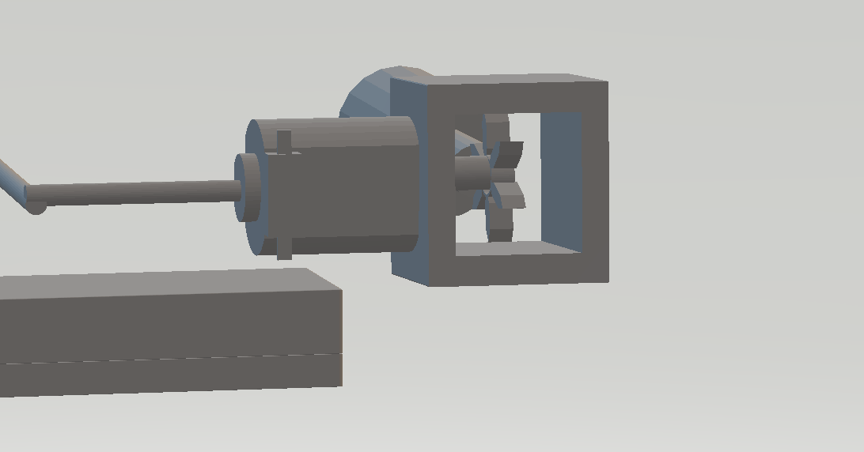
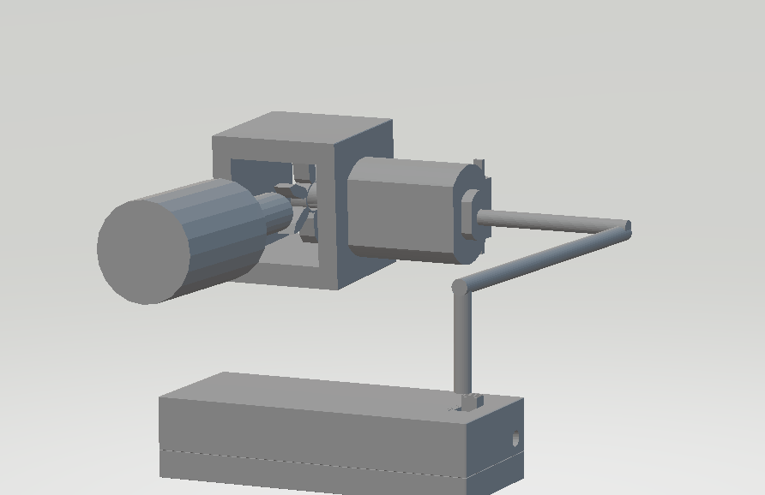

Slide 7
This project’s cost is not expensive.If any company help me,we can do it.So,we can sell it.In this way,this product can use to every car and on factory chimneys.

